Slide 1
Introduction to Computer Networks 22CS008
Wireless WAN
Cellular Telephone & Satellite Networks
Dr. Htet Ne Oo
Department of Computer Science and Engineering,
Chitkara University, Punjab

Slide 2
Introduction
To accommodate a large number of users over a large geographic area, the cellular telephone system uses a large number of low-power wireless transmitters to create cells.
Variable power levels allow cells to be sized according to subscriber density and demand within a particular region.
A cell is a basic geographic unit of a cellular system. The term cellular comes from the honeycomb shape of the areas into which a coverage region is divided. Cells are base stations transmitting over small geographic areas that are represented as hexagons. As mobile users travel from cell to cell, their conversations are handed off between cells.
Channels (frequencies) used in one cell can be reused in another cell some distance away, which allows communication by a large number stations using a limited number of radio frequencies. To summarize, the basic concept of reuse allows a fixed number of channels to serve an arbitrarily large number of users.

Slide 3
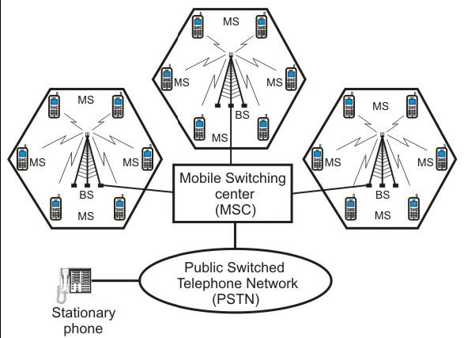
Figure 1. Schematic diagram of a cellular telephone system

Slide 4
Cellular telephony
Cellular telephony is designed to provide communications between two moving units, called mobile stations (MSs), or between one mobile unit and one stationary unit.

Slide 5
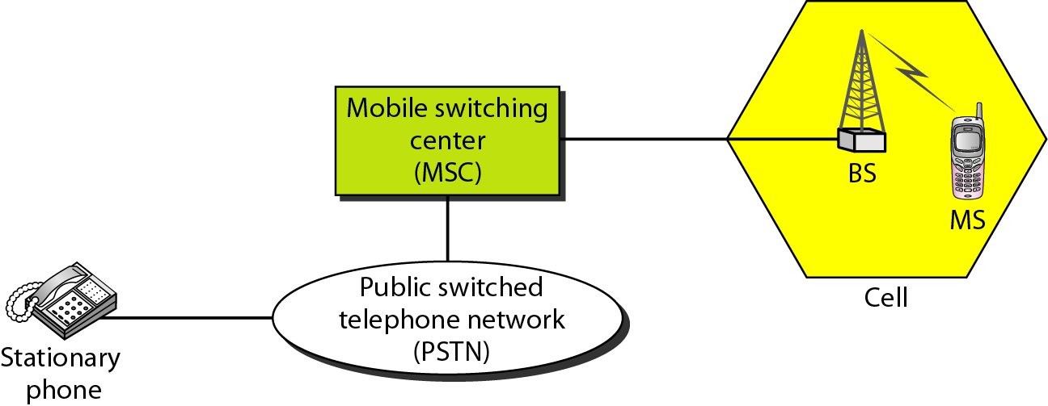
Cellular System
Figure 2. Cellular System

Slide 6
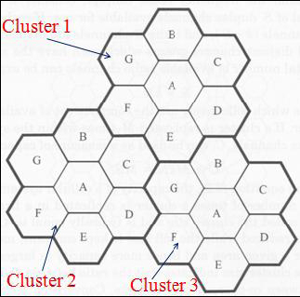
Frequency reuse
Frequency reuse is the process in which the same set of frequencies (channels) can be allocated to more than one cell, provided the cells are separated by sufficient distance. The figure shows a geographic cellular radio coverage area containing three groups of cells called clusters. Each cluster has seven cells in it, and all cells are assigned the same number of full-duplex cellular telephone channels. Cells with the same letter use the same set of channel frequencies. A, B, C, D, E, F and G denote the seven sets of frequencies.
Figure 3. Geographic cellular radio coverage area with three clusters

Slide 7
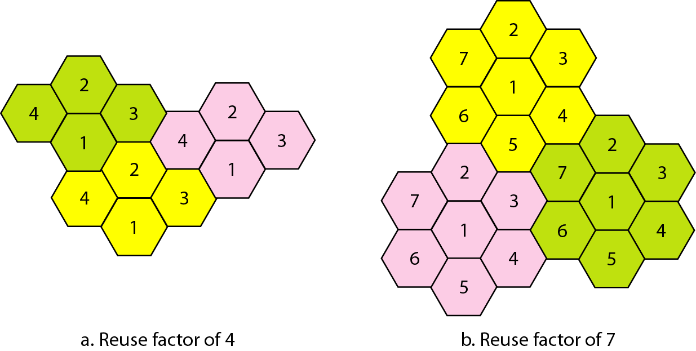
Frequency Reuse Patterns
Figure 4. Frequency Reuse Patterns

Slide 8
Handoff
The automatically changing of the frequency when the mobile unit moves from one location to another location without knowing by user is called Handoff.
Handoff’s are two types called hard handoff and soft handoff
In a hard handoff, which was used in the early systems, a MS communicates with one BS. As a MS moves from cell A to cell B, the communication between the MS and base station of cell A is first broken before communication is started between the MS and the base station of B. As a consequence, the transition is not smooth. Hard handoff is often called as break before-make. A hard handoff is perceived by network engineers as an event during the call.
In soft handoff, For smooth transition from one cell (say A) to another (say B), an MS continues to talk to both A and B. As the MS moves from cell A to cell B, at some point the communication is broken with the old base station of cell A. This is known as soft handoff (also called as make before break).

Slide 9
First Generation Analog Cellular Telephone
AMPS (Advanced Mobile Telephone System) was invented at Bell Labs and initially deployed in the U.S. in the early 1980's.
The frequencies allocated to AMPS by the Federal Communications Commission (FCC) range between 824 to 849 MHz in reverse channels (mobile to base) and 869 to 894 MHz in forward channels (base to mobile).
Simultaneous transmission in both directions in a transmission mode is called full duplex (FDX) or simply duplexing.
Frequency-division duplexing (FDD) is used with AMPS and occurs when two distinct frequency bands are provided to each user.
A special device called duplexer is used in each mobile unit and base station to allow simultaneous transmission and reception on duplex channels.

Slide 10
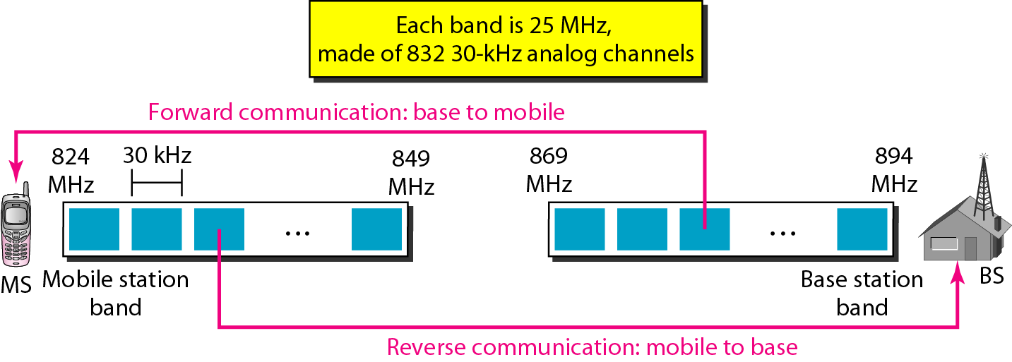
Cellular Bands for AMPS
Figure 5. Cellular Bands for AMPS

Slide 11
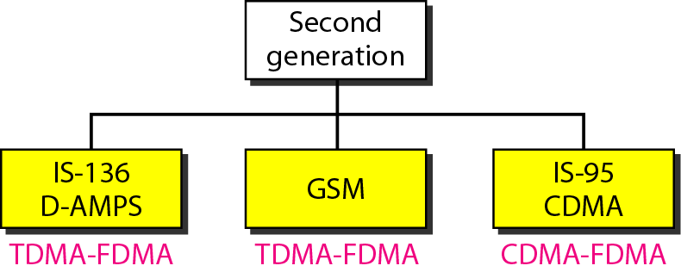
Why we go for 2nd Generation
First generation cellular system were designed for a limited customer base.
When the customers increased, manufacturers searched for new technologies to improve the inherent problems with the already existing cellular telephones such as poor battery performance and channel unavailability.
Improved batteries are needed to reduce the size, cost of the mobile units, especially those are used for handheld.
Weak signal strengths resulted in poor performance.
The solution for the limitations are employing the digital technologies which improve the battery performance and higher signal quality.
Figure 6. 2nd Generation Cellular System

Slide 12
GSM Access Methods
FDM too wasteful
TDMA - time-division multiple access
early lead - more successful experience
CDMA - code-division multiple access
theoretical advantages
increased range
choice for 3rd generation

Slide 13
Digital Cellular Telephone
With the rapidly expanding customer base while working with unchanged allocated frequency spectrum, it was a growing problem for the cellular companies.
Digital cellular telephone systems have several inherent advantages over analog cellular telephone systems, including better utilization of bandwidth, more privacy and incorporation of error detection and correction. Consequently, the United States Digital Cellular (USDC) system was designed and developed with the intent of supporting a higher user density within a fixed-bandwidth frequency spectrum.
Cellular telephone systems that use digital modulation, such as USDC, are called digital cellular. USDC cellular systems comply with IS-54, which specifies dual-mode operation and backward compatibility with standard AMPS and because of this reason, they are also known as Digital AMPS (D-AMPS or DAMPS).
The USDC system has an additional frequency band in the 1.9 GHz that is not compatible with AMPS frequency allocation.

Slide 14
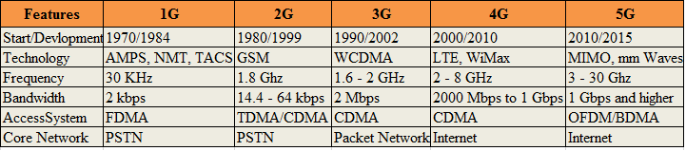
Difference between 1G, 2G, 3G, 4G and 5G

Slide 15
6G
6G (sixth-generation wireless) is the successor to 5G cellular technology.
6G networks will be able to use higher frequencies than 5G networks and provide substantially higher capacity and much lower latency.
One of the goals of 6G internet will be to support one microsecond-latency communication. This is 1,000 times faster -- or 1/1000th the latency -- than one millisecond throughput.
The 6G technology market is expected to facilitate large improvements in imaging, present technologies and location awareness.
6G is expected to support data rates of 1 terabyte per second. Access points will be able to serve multiple clients simultaneously.
This level of capacity and latency will extend the performance of 5G applications and expand the scope of capabilities to support innovative applications in wireless connectivity, cognition, sensing and imaging.

Slide 16
Satellite Networks
A satellite network is a combination of nodes, some of which are satellites, that provides communication from one point on the Earth to another. A node in the network can be a satellite, an Earth station, or an end-user terminal or telephone.

Slide 17
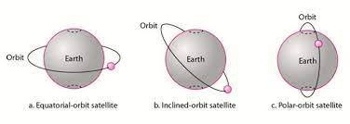
Satellite Orbits
Figure 7. Satellite Orbits

Slide 18
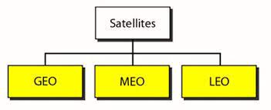
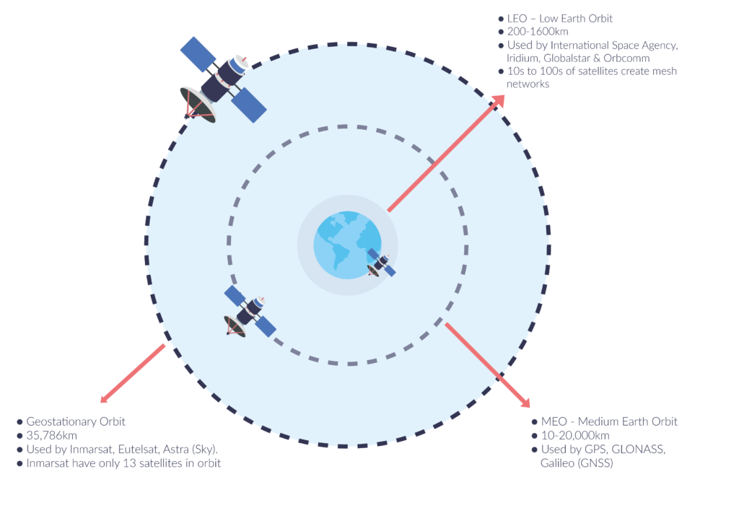
Satellite Categories
Figure 8. Satellite Categories

Slide 19
Geosynchronous Orbit (GEO) Satellite Systems
Advantages:
large area coverage, stay where they are at 35,786km (22,000miles) above the Earth.
Satellite rotation is synchronous to earth.
Three satellites can cover the whole globe low system complexity
Disadvantages:
long propagation delay (~125 msec).
High transmission power is required

Slide 20
Medium Earth Orbit (MEO) Satellite Systems
Advantages:
Slightly longer propagation delays (~40 msec).
Slightly higher transmission power required
More expensive than LEOs but cheaper than GEOs.
Disadvantages:
Coverage spot greater than a LEO, but still less than a GEO
Still the need to be in rotation to preserve their low altitude 6-8 hours to circle the earth.
Multiple MEO satellites are still needed to cover a region continuously handovers and satellite tracking are still needed, hence, high complexity

Slide 21
Low Earth Orbit (MEO) Satellite Systems
Advantages:
Short propagation delays (10-15 msec).
Low transmission power required low price for satellite and equipment.
Disadvantages:
Small coverage spot.
They have to be in rotation to preserve their low altitude (90 mins period).
A network of at least 6 LEO satellites is required to cover a region continuously.
High system complexity due the need for handovers and satellite tracking

Slide 22
Global Position System (GPS)
Operated by the US Department of Defense.
Orbiting at an altitude about 18,000km.
Consists of 24 satellites in 6 orbits; 32 by Dec 2012.
At any time, about 9 (>4) satellites are visible from any point on Earth.
A GPS receiver has an almanac that tell the current position of each satellite

Slide 23
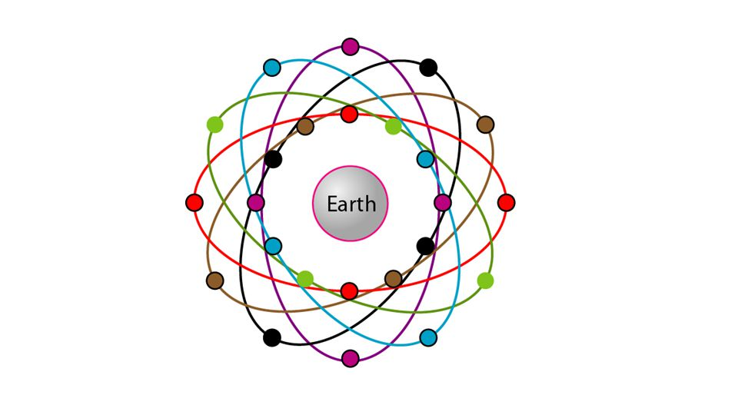
Orbits for GPS satellites
Figure 9. Orbits for Global Positioning System (GPS) Satellites

